Slide 1
Emergency Preparedness Training for Building Coordinators
Presented by the Missouri S&T University Police Department
Revised: September 2023

Slide 2
Building Coordinators
This is a volunteer position. If you are not interested in being a building coordinator, please let the University Police Department know as soon as possible.
The Building Coordinator is interested in the safety and security of their respective building and are willing to take on the role to help the building occupants with training needs and in emergency situations.
The Building Coordinator is a very important partner of the University Police Department and serves as a liaison between the respective building at the University Police Department.

Slide 3
Emergency Management Plan
https://police.mst.edu/emergencies/
Scan the code for a copy of the Emergency Operations Manual

Slide 4
Missouri S&T Emergency Alert Notification System
https://police.mst.edu/emergencies/notification/
Missouri S&T maintains an alert website with up-to-date information on issued alerts, precautionary messages, and campus operating conditions. In addition, Missouri S&T’s Mass Notification System (MNS) is designed to alert the campus community to a potential threat or emergency situation via SMS, phone and email.

Slide 5
What to do in an Emergency
Secure-In Place: Place a locked door between you and the danger
Shelter-In-Place: Move inside to a building space that protects you from danger. Do not lock doors behind you as other may need to Shelter-In-Place.
Evacuation: A building evacuation may occur during a life safety event that affects the normal operations of an individual building on campus.

Slide 6
What is the Building Coordinators role?
Develop an emergency plan for their building and coordinate with the University Police.
Inform building occupants of emergency.
Assist building occupants.
Liaison with public safety responders.
Report emergency situations.
This group is the backbone of campus emergency/disaster preparedness at Missouri S&T.

Slide 7
Circumstances that may warrant an evacuation
Fire
Hazardous Material Spill
Bomb Threat
Gas leak
Active Shooter

Slide 8
Duties of the Building Coordinator during an Evacuation
React immediately to the alarm, message or notification of the need for evacuation.
Gather phone lists (bring your purse/wallet, cell phone and ID)
Start occupants moving in the right direction in an orderly manner.
Assist any occupants who may need help evacuating the building.

Slide 9
Once the Building is evacuated
Direct occupants to the direction of the Rally area.
When the building is empty give the status report to first responders.
Organize the rally area.
Conduct a roll call if possible and stay in place until given instructions.

Slide 10
Shelter-in-Place
Shelter-in-Place is a protective action taken inside a building to protect the building occupants from external hazards, minimize the chance of injury and/or provide the time necessary to allow for a safe evacuation.

Slide 11
Where should you take Shelter?
It depends on your reason for sheltering in place.
If a weather event, get indoors and away from windows.
If an active shooter get behind a locked door or barricade a solid door. Take cover.
If there is a hazardous substance in the area, follow directions based on the type of hazard.

Slide 12
What is the Building Coordinators role?
Develop an emergency plan for their building and coordinate with the University Police.
Inform building occupants of emergency.
Assist building occupants.
Liaison with public safety responders.
Report emergency situations.
This group is the backbone of campus emergency/disaster preparedness at Missouri S&T.

Slide 13
Duties of the Building Coordinator during a Shelter in Place Event
Assume the role of Building Coordinator
Activate your Shelter Plan
Give directions to others in the building
Maintain calm and order during the event.

Slide 14
What if someone is trying to enter a secure area?
Use good judgement
Try to see if it’s a trap
If a physical description was given of the subject, try to determine if they match those similarities
If you decide to let the person in
Have them leave anything they are carrying outside
Have lift up the clothing until waistline is visible and make them rotate 360 degrees to see if they are carrying a concealed weapon

Slide 15
Secure in place for an Active Shooter
Remain calm. People will be looking to you for direction.
If you are outside, seek cover in the nearest unlocked building. If the building is locked, continue to move away. Seek cover, move to another building or leave campus.
Once inside find an interior room and barricade the doors.
Turn off the lights, silence your phone, close the blinds and hide out of sight.
Await further instructions.
Do not leave until given the all clear.

Slide 16
Encountering First Responders
Follow Officers Instructions (Remain Calm)
Keep your hands visible at all times
Drop all items you are carrying and immediately raise your hands and spread your fingers
Avoid yelling or making quick movements towards officers
Don’t stop to ask Officers questions

Slide 17
In the event of active shooter, once information is received by the University Police, a mass notification message will be generated. As much information as possible will be pushed out through the message. Expect follow-up messages and when the situation is resolved an “all-clear” message will be sent.
Remember, you could be the first person to see or hear the incident. Call 911 and give as much information to the operator as possible. Report your name, location, number of assailants, injuries (nature), and do not hang up.
If you are in an office or classroom, you should follow the Run-Hide-Fight protocols. If you can safely run from the situation than run, if you can’t run, find a room, secure the room, and hide, if faced with the perpetrator, you may find yourself in a position that you may have to fight. Keep in mind that you may have to run, to hide or you may have to fight and then run and hide.

Slide 18
There is no cookie-cutter answer for what to do in the event of an active shooter. Following the Run-Hide-Fight procedure will push you to follow the safest actions. Stay alert and aware of cover.
As a building coordinator people will be likely looking to you for advice, similar to other emergencies, it is very important that you stay as calm as possible and provide the best direction you can based on the information that you know.
The RAVE Guardian App is a free App that the University has purchased. You can text the University Police or use a button on the App to call 911.
The University has numerous cameras in place. The University Police share the views with the Rolla 911 call-center.

Slide 19
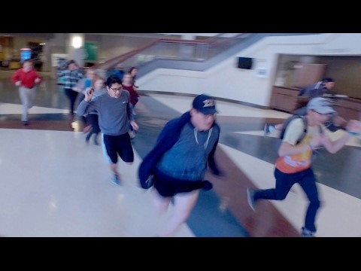
Run, Hide, Fight – Surviving an Active Shooter Event
https://www.youtube.com/watch?v=BPQpj_k_Fl4

Slide 20
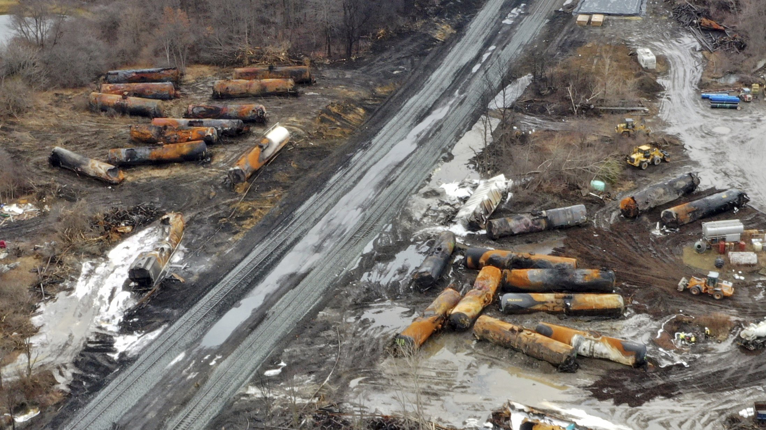
Shelter In Place for a Hazmat release into the Environment
Bring bottled water and any foods that are non-perishable
Bring prescriptions medication and a first aid kit if available
Bring duct tape, plastic bags, cell phone
Once the door is closed, secure and maintain room integrity

Slide 21
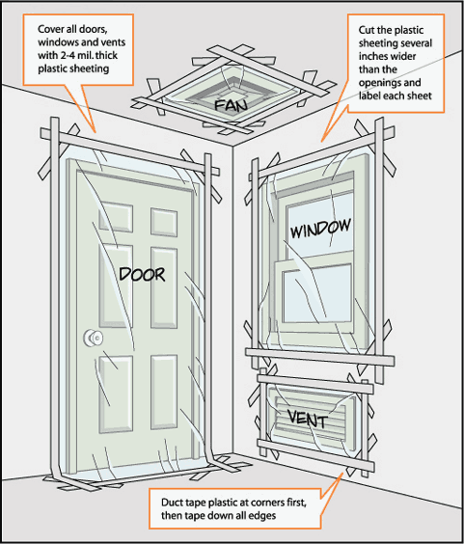
Cover all doors, windows and vents with plastic. Cut several inches wider. Tape corners first, then tape down all edges.

Slide 22
Medical Emergency
The campus community in encouraged to learn CPR with AED and first aid. The University Police provide CPR/AED and first aid classes.
Avoid leaving the injured/ill person except to summon assistance.
Assess and if needed or in doubt, call 911.
Inform first responders of any pertinent information related to the victim.

Slide 23
Suspicious Package
Do not touch or move it. Call 911 and get people away. If in doubt call 911
Signs of a suspicious package:
Notations the contents are “personal” or “confidential”
Excessive postage or a rigid or lopsided envelope
Discolorations on the package or envelope indicating a liquid
Wire or tinfoil protruding with excessive tape or string
No return address and incorrect titles on the address

Slide 24
Suspicious package

Slide 25
Fire
Activate the fire alarm system and assist with the building evacuation. Close (but not lock) doors behind you.
Call 911 and inform the operations of as much information as possible including if people are still in the building.
Direct occupants to the pre-designated assembly area.
If appropriate and safe, use a fire extinguisher.

Slide 27
Tornado or Severe Weather
A tornado warning issued by the National Weather Service will result in an alert generated through our Emergency Mass Notification System. Local sirens will also announce a tornado warning as an audible alert.
Shelter in place in a basement or below ground location. At the very least, seek shelter on the lowest floor of the building. If possible, move to interior hallways and or center room with no windows. Stay close to the floor.

Slide 28
Tornado or Severe Weather
Although the National Weather Service does not issue an all-clear warning, the University will utilize the mass notification system to announce updates and a message noting the severe weather threat has expired. People are encouraged to listen and monitor local media sources for updates. There are several local television and radio stations that will provide emergency broadcasting information.

Slide 29
Building Coordinator’s Emergency Plan
Key Elements
Identifies the building Coordinator and Alternate
Identifies 2 Rally Evacuation areas
These areas should be at least 300 feet away (500 for a bomb threat) from the affected building and not near power lines or generators.
Parking lots, hydrants and walkways should be kept clear.
What supplies and equipment available needs to be reviewed and updated every year. Needs to be available to all faculty and staff in the building.

Slide 30
The building emergency action plan should be kept in a visible location that is readily accessible to building occupants, (i.e. put in a red folder or binder in an accessible area).

Slide 31
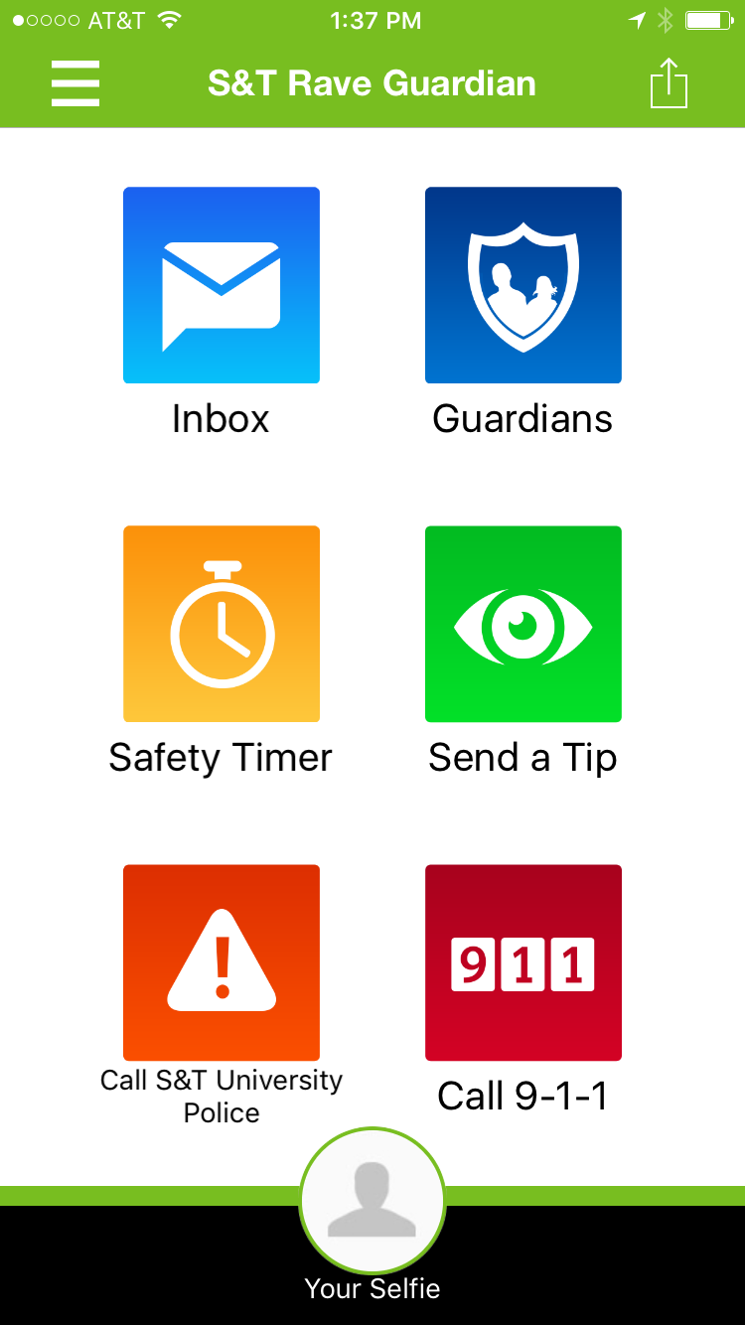

Slide 32
University Police Contacts
Police Chief Doug Roberts PH: 341-4345
Sgt. Brandon Guth PH: 341-6654

